Slide 1
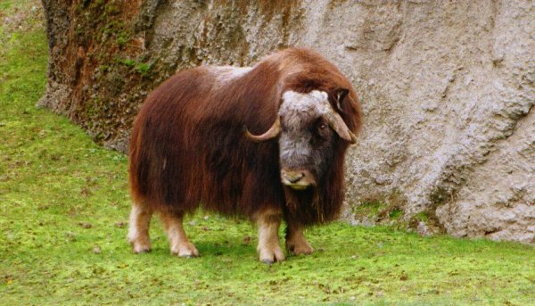
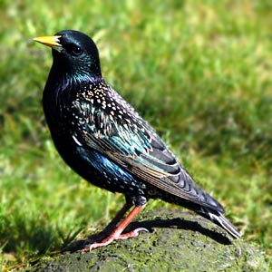
Presentation 1:
Introduction to Population Modeling and Exponential Growth

Slide 2
Population:
A population ecologist:

Slide 3
Mathematical models in population ecology

Slide 4
Many practical applications
Fisheries harvest regulation
Wildlife management
Pest control
Forest harvest planning
Disease control strategies
Protection of threatened species

Slide 5
Discrete time exponential growth model

Slide 6
What are the assumptions of the exponential growth model?

Slide 7
Simple vs. complex models

Slide 8
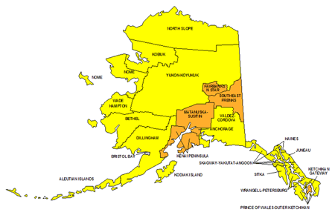
Using the exponential growth model
R=1.148

Slide 9

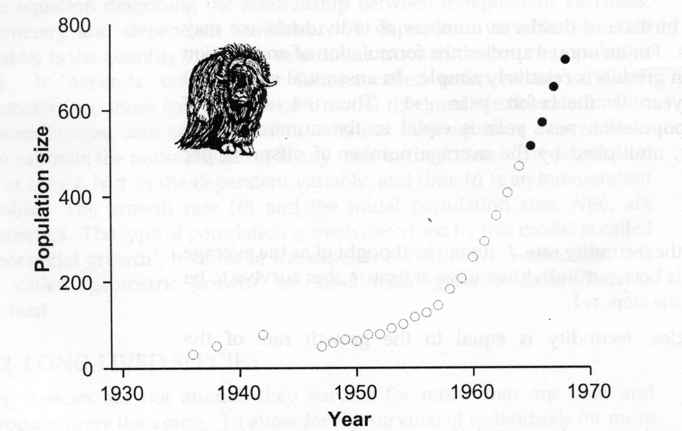
Observed growth

Slide 10
Predict future population size
If the population size is 514 in 1965,
what will the population size be in 1968?

Slide 11
Doubling time
How long will it take the population to double in size?

Slide 12
Migration, harvesting and translocation
We estimated that in 1968, there would be 778 muskox. However, there were only 714.
This is because 48 animals were translocated to other sites in Alaska.
How many animals can be sustainably harvested each year?

Slide 13
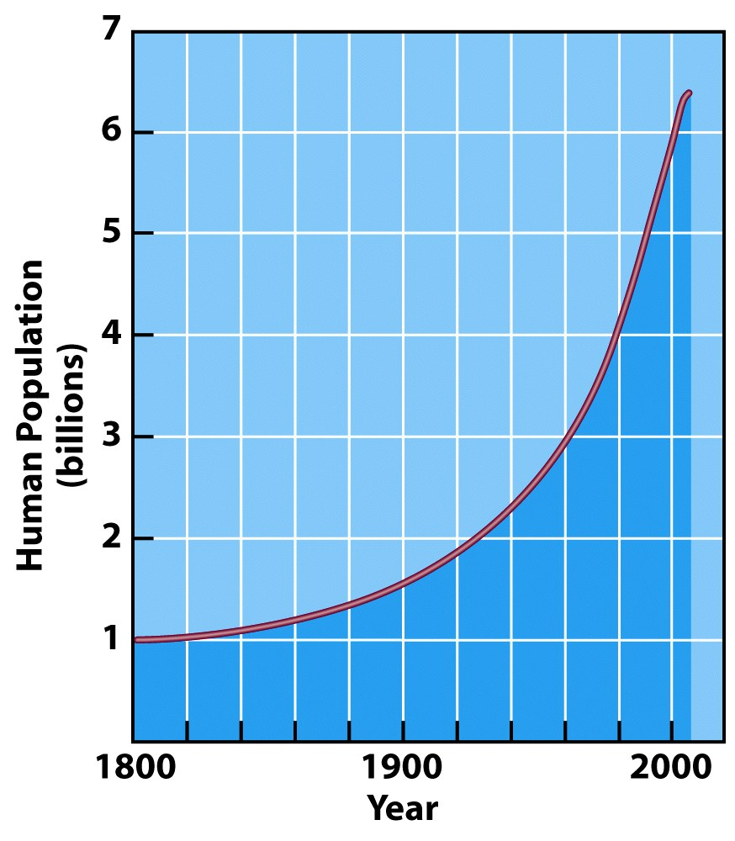
Human population growth
Growth rate:
N₁₈₀₀=N₁₉₅₀ R¹⁵⁰
R=1.0068

Slide 14
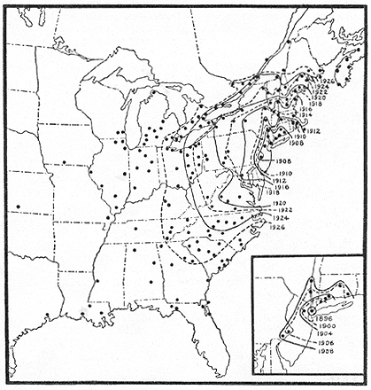
European starling spread
In 1890, 80 birds were released in Central Park, New York City. Starlings have spread to Nova Scotia, to the Mississippi River, to central Ontario, and to the Gulf of Mexico.

